Slide 1
Understanding Ionization Variance from Sub-keV Nuclear Recoil Events in Direct Detection Dark Matter Experiments
Mitchell Matheny
University of Colorado Denver

Slide 2
Prior Work: Superconducting Electronics Lab
Nano-SQUID (Undergrad)
Systems integration
Probe design via fusion 360 / CAD
Cryogenic Dark Matter Survey (CDMS)
Lab Management
Testing and characterization of superconducting quantum interference devices.
Data acquisition system (DAQ) analysis / troubleshooting
Magnetic field sensitivity measurements.

Slide 3
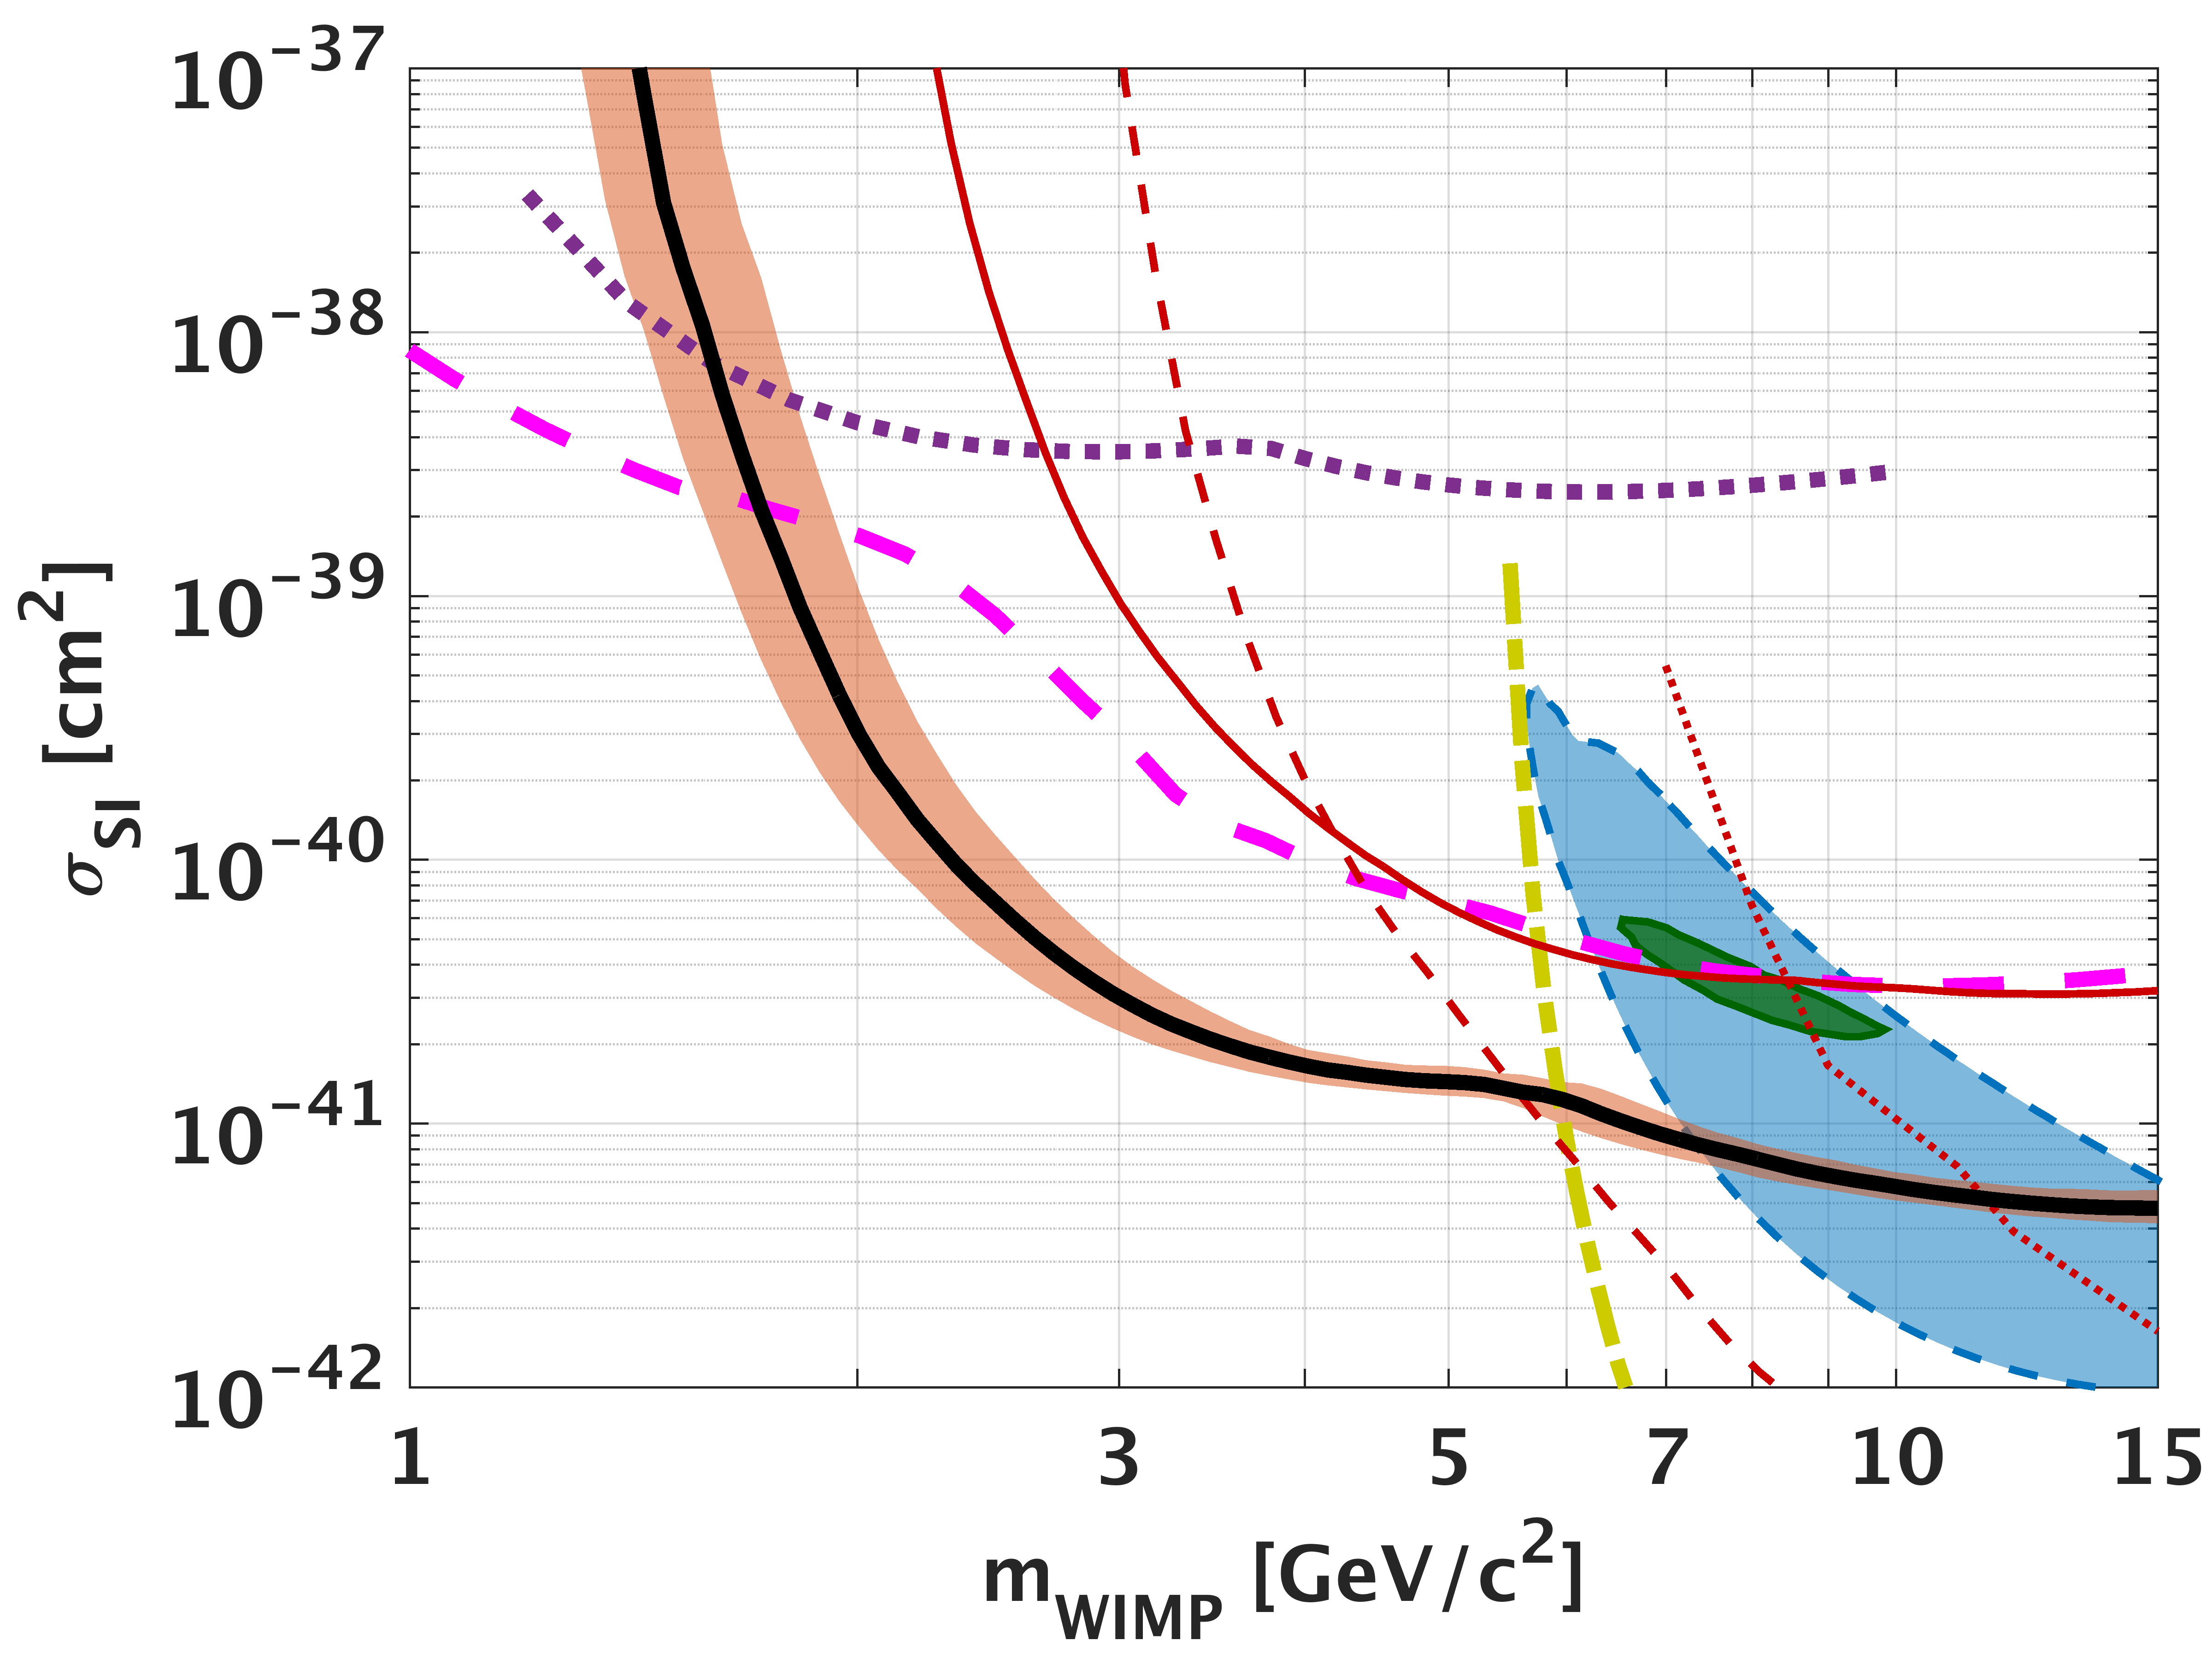
Dark Matter
Dark matter has been theorized to be Weakly Interact Massive Particles(WIMPs) with masses on the order of a GeV/c² to a few TeV/c^{2.}
In the post Minimal Supersymmetric Standard Model era, we are completely in the dark on the dark matter mass.
Dark matter could still be "WIMP" like in that it could interact with nuclei - but < 70 GeV masses are increasingly of interest.
CDMSlite
SuperCDMS
CRESST
LUX
DOI: 10.1103/PhysRevLett.116.071301
Notes:
Going to Focus on WIMPS only.
Dark Matter experiments such as CDMS and CREST are trying to push down to lower thresholds.
The detects that are trying to do this are solid state detectors with some sort of voltage applied to them. They are essentially electron-hole pair counters.

Slide 4
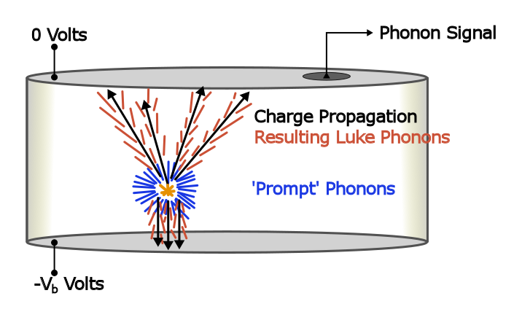


Charge Creation and Detection in CDMSlite
Electron-Hole pairs and Prompt Phonons are liberated when particle interacts with the nuclei in the detector. (Silicon or Germanium)
These detectors measure total phonon energy. Which make them really good electron-hole pair counters due to the Luke-Neganov effect.
Notes:
A WIMP comes in a hits the nuclei, initial phonons are produced and charge is liberated in some ratio. Current generation of lowest threshold detectors only count the number of produced electron hole pairs. We do not have a good nuclear recoil calibration standard. Therefore to extract the nuclear recoil energy we have to know the ratio of recoil energy that goes into the electronic system.
Variation in energy given to the electronic system exists because a single E_r can create a spectrum of a possible number of electron hole pairs
Solid State detector with a voltage across it. For the purpose of this talk.

Slide 5


Electron – Hole Pair Creation
Electron Recoils
The ionization yield Y converts from recoil energy Er to the average number of electron-hole pairs produced <Neh>
The mean number of electron hole pairs produced varies greatly for electron recoils and nuclear recoils.
Measurements of charge and phonon would mean great discrimination between electron and nuclear recoils (far better than PSD and liquid scintillators)
Nuclear Recoils
This makes the energy scale for nuclear
recoils nonlinear.
Notes:
A WIMP comes in a hits the nuclei, initial phonons are produced and charge is liberated in some ratio. Current generation of lowest threshold detectors only count the number of produced electron hole pairs. We do not have a good nuclear recoil calibration standard. Therefore to extract the nuclear recoil energy we have to know the ratio of recoil energy that goes into the electronic system.
Variation in energy given to the electronic system exists because a single E_r can create a spectrum of a possible number of electron hole pairs

Slide 6
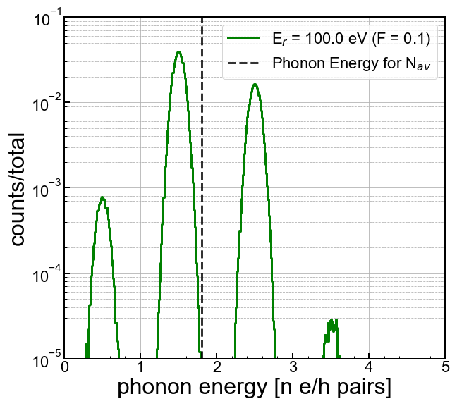
HVeV Detector and a Single E_{r}
A detector developed at Stanford has developed a detector that can support 160V bias and a 14eV resolution.
DOI 10.1063/1.5010699
Given this high sensitivity, the spectrum for a single E_{r} looks different than you might expect - this is due to randomness in electron-hole pair production
Each peak represents a different number of electron hole pairs produced.
Notes:
Citation for HVeV

Slide 7
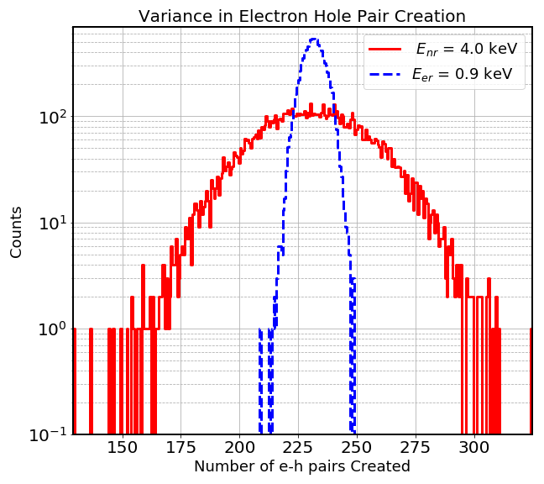
Variation in Electron Hole Pair Creation
A measurement has been made in silicon for this phenomena.
DOI. 10.1103/PhysRevA.45.2104
The number of electron hole pairs produced varies for a single nuclear recoil energy.
It also varies for electron recoils, but much less.
The variance in eh pairs produced by a nuclear recoil significantly impacts any nuclear-recoil signal spectrum
Notes:
There is a variant number of electron hole pairs exists for a given Er for both electron recoils and nuclear recoils.

Slide 8
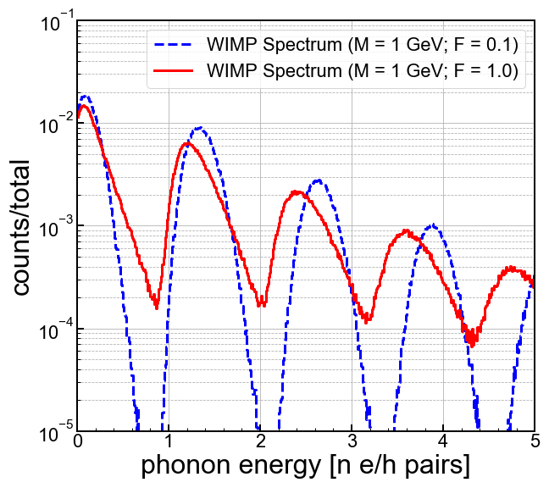
HVeV Detector and a Dark Matter Spectrum
For detectors that count eh pairs, the variance in Neh can dramatically affect low-mass dark matter searches
Different variation in Neh changes the interpretation of observed experimental spectra.
Notes:
Will talk more about it. Less bullet points.

Slide 9
HVeV Detector and a Dark Matter Spectrum
Event at 3.5 e/h pairs
F = 1
F = 0.1
Notes:
Will talk more about it. Less bullet points.

Slide 10
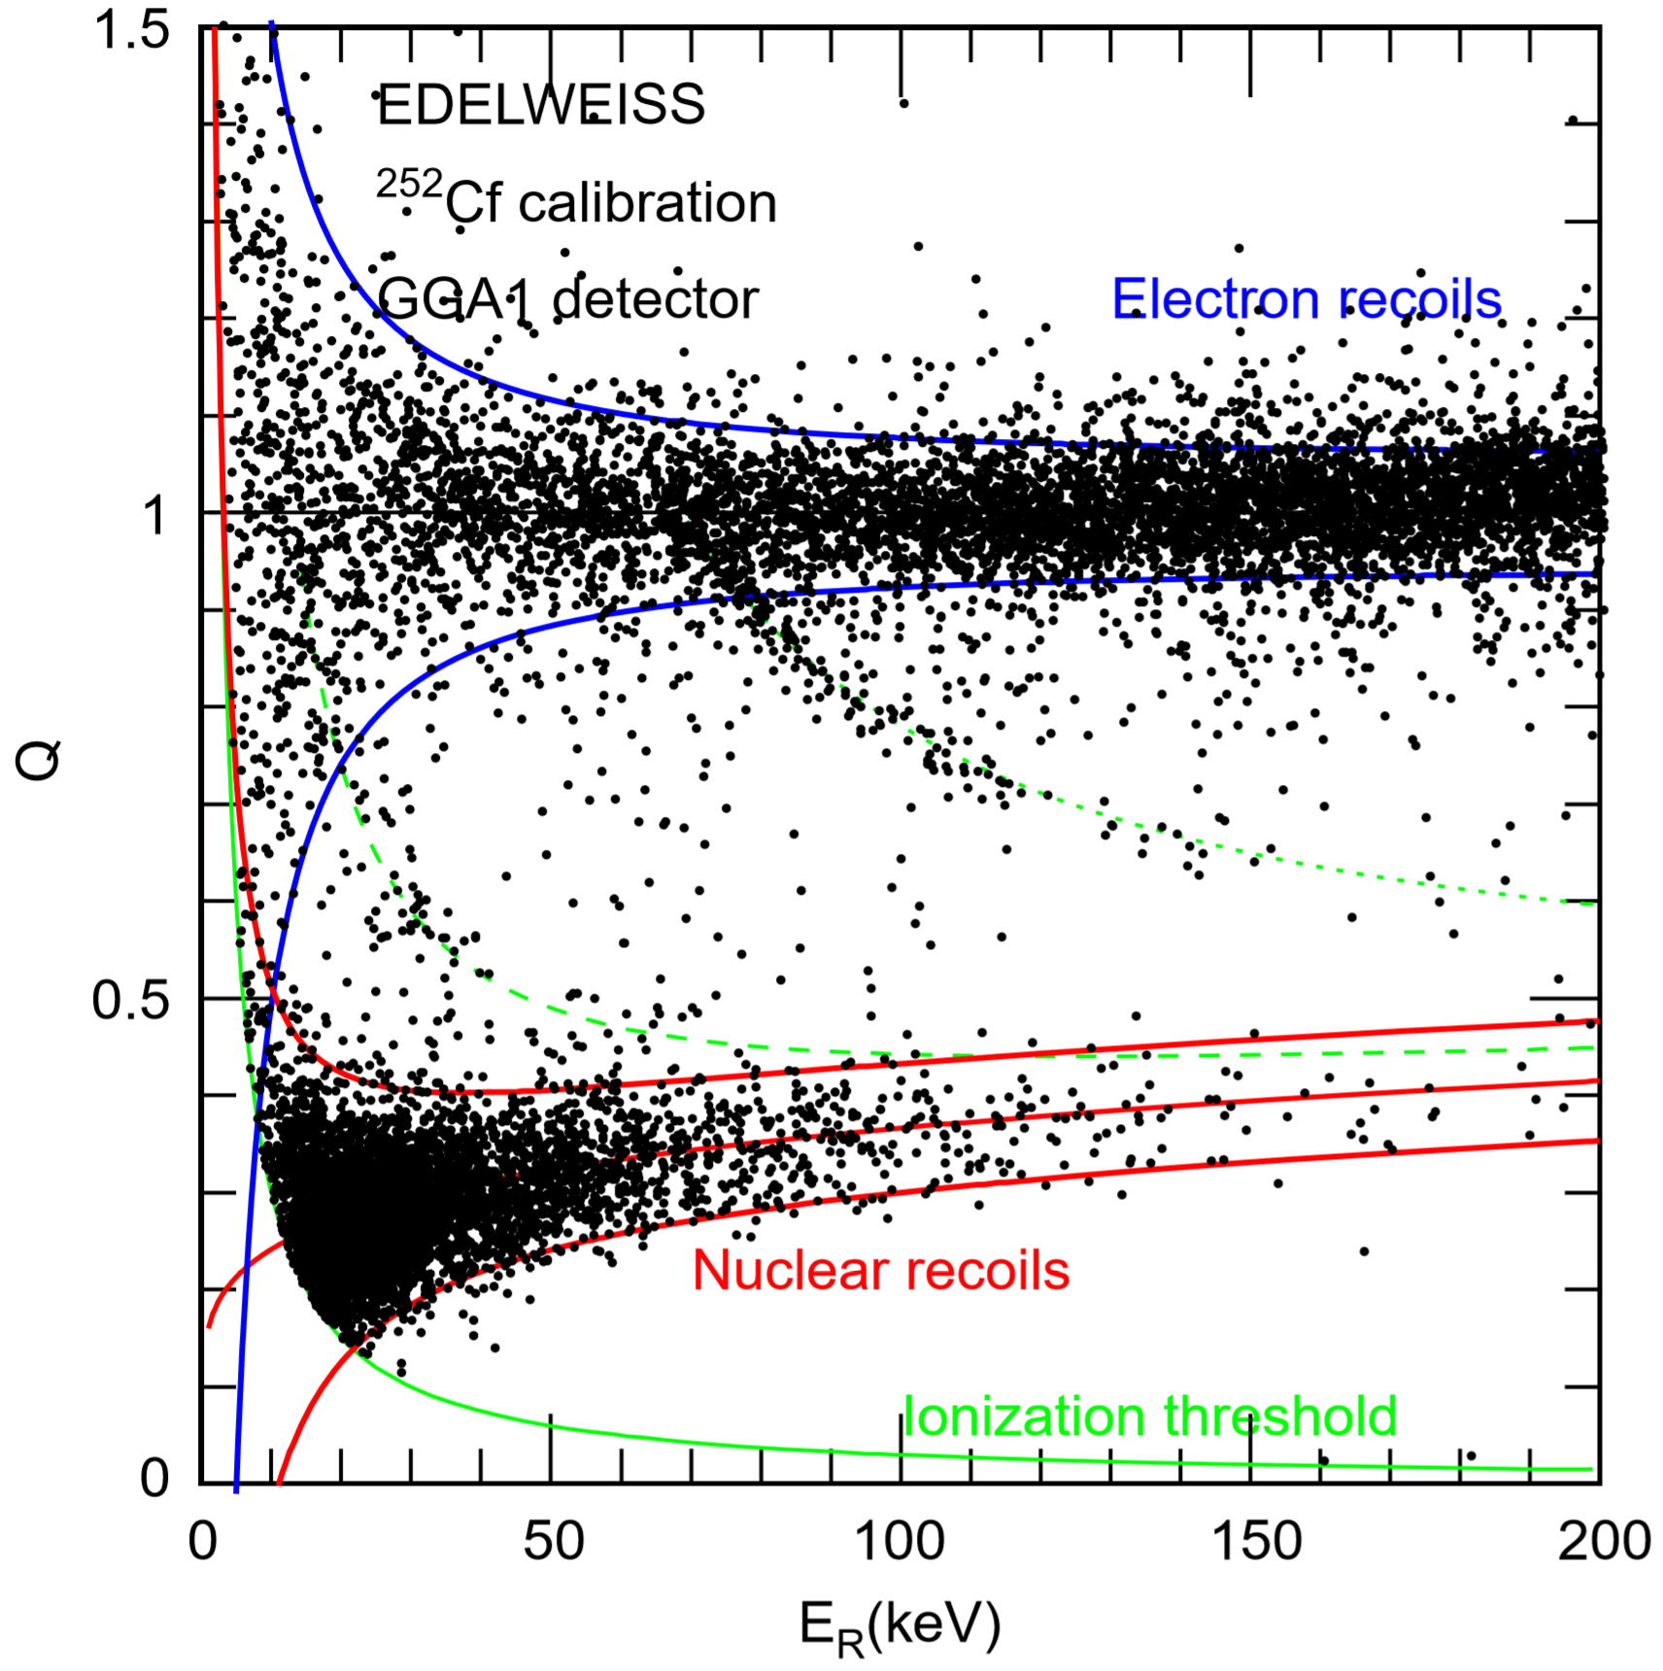
Quantifying Ionization Variance
Ability to directly to measure charge and phonons separately. Allowing for a direct measurement of the ionization efficiency.
Should be able to extract the width of the nuclear recoil band.
Allows quantify the variation in electron hole pair production.
DOI 10.1016/j.nima.2004.04.218
Notes:
They can measure charge and phonons separately, this gives them a direct measure of the yield.

Slide 11
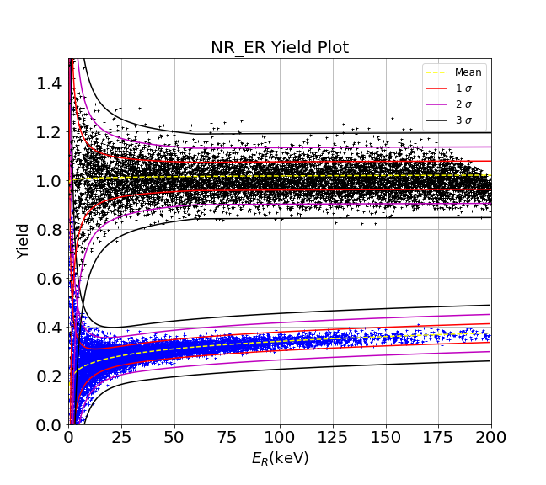
Quantifying Ionization Variance
SIMULATED
Notes:
They can measure charge and phonons separately, this gives them a direct measure of the yield.

Slide 12

Quantifying Ionization Variance
SIMULATED
Notes:
They can measure charge and phonons separately, this gives them a direct measure of the yield.

Slide 13
Summary
There exists a variance in the number of electron hole pairs created for a single nuclear recoil energy.
This variance is well understood (due to linearity) for the electron recoil band.
This variance in e-h production for a nuclear recoil can dramatically effect the energy reconstruction of a WIMP (or any other particle) when it interacts with a detector.
Currently working on how to validate the model with data for nuclear recoils. Will then look into other possible explanations for this variance… i.e. multiple scattering, atomic binding energy, etc.
Notes:
Bands from data -> simulated bands. Side by side.

Slide 14
Back Up Slides

Slide 15
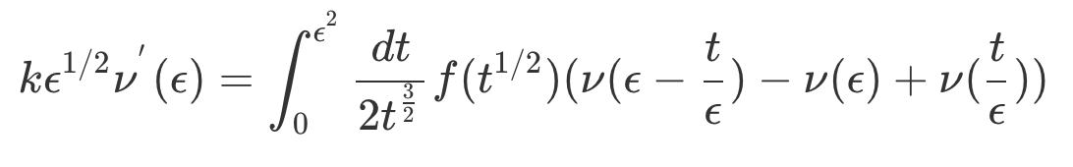
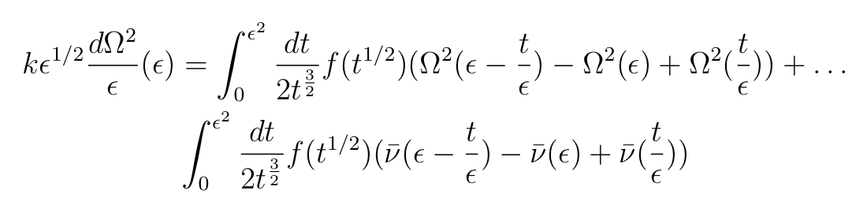
Lindhard Model

Slide 16
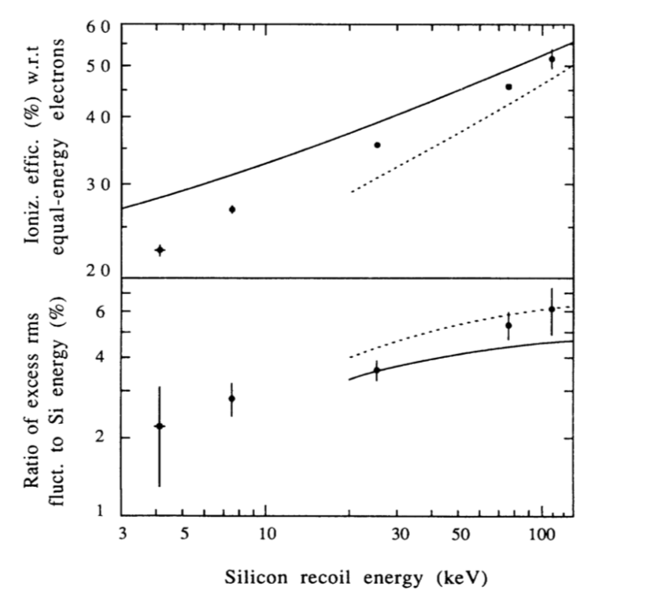
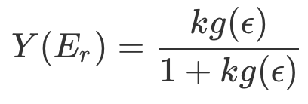
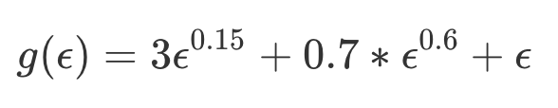
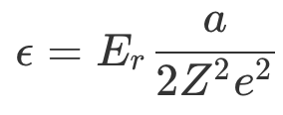
Lindhard Model and Ionization Yield
The amount of energy given to the electronic system.
A measurement has been made for silicon and germanium.

Slide 17
Whats Wrong with Lindhard?
Lindhard makes a few assumptions in his model:
Ionized electrons do not produce recoil atoms of appreciable energy
The energy given to the atomic binding energy is negligible.
Variation in the number of electron hole pairs produced is not accounted for. (What I will focus on)
Could be a constant term, but is more than likely energy dependent.
Charge trapping (Looking into, really cool E/m problem)
Low energy nuclear recoils may create a “Cloud” of charge. This effectively cancels out the applied voltage and doesn’t allow the freed charge to traverse the detector and be collected. (i.e e-h pairs recombine)
Effects due to multiple scattering not accounted for. (Beginning to look into)
WIMP scattering
Phonon Scattering

Slide 18
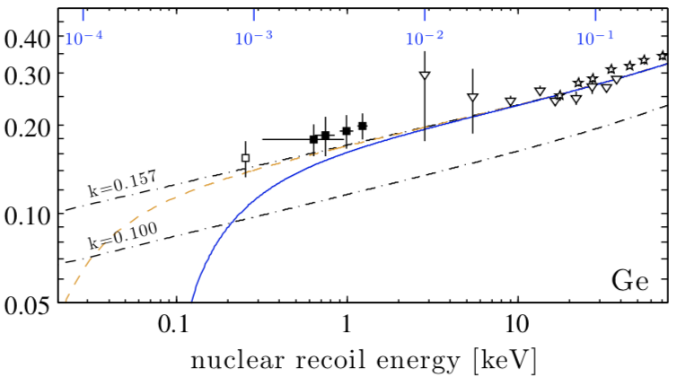
Atomic Binding Energy Correction
Notes:
Hypothesis on including the atomic binding energy introduces a kinematic cutoff can be incorporated by adding a constant q to Eq.

Slide 19
Fano Factor
Variation in the number of electron-hold pairs produced given a single recoil energy.
This is well understood for electron recoils.
F(silicon) = 0.13 , F(germanium) = 0.12
This is not understood for nuclear recoils.
Lindhard does make a prediction for this quantity, but has very little effect for recoil energies above 10keV and therefore has been neglected.
Notes:
This is well understood for electron recoils.
F(silicon) = 0.13 , F(germanium) = 0.12

Slide 20
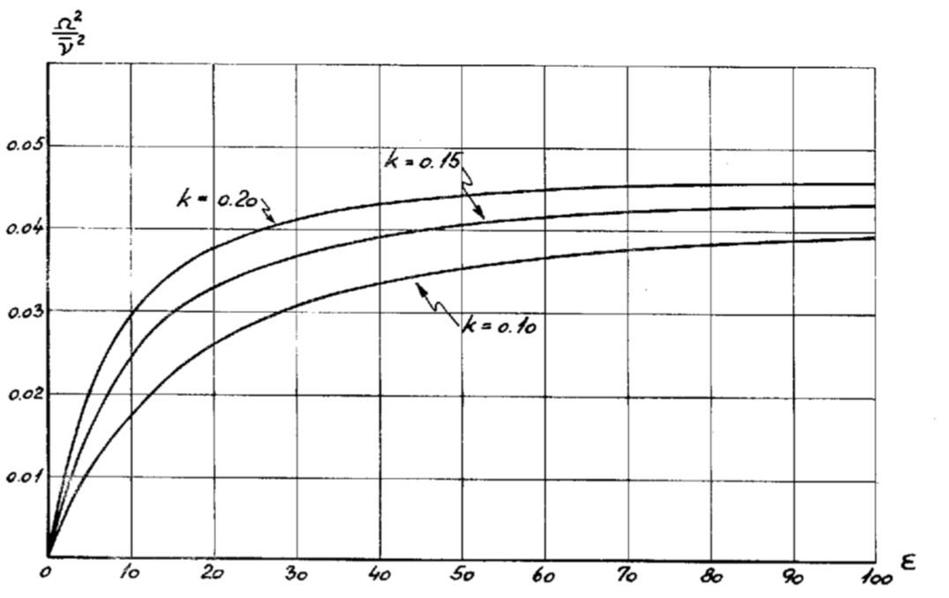
Lindhard Fano Factor

Slide 21
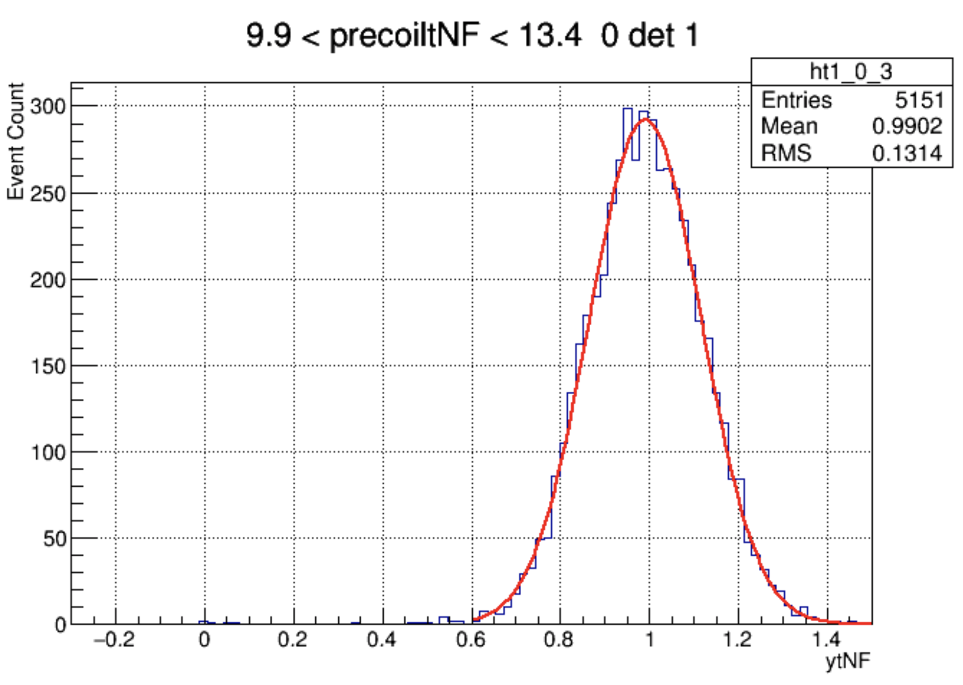
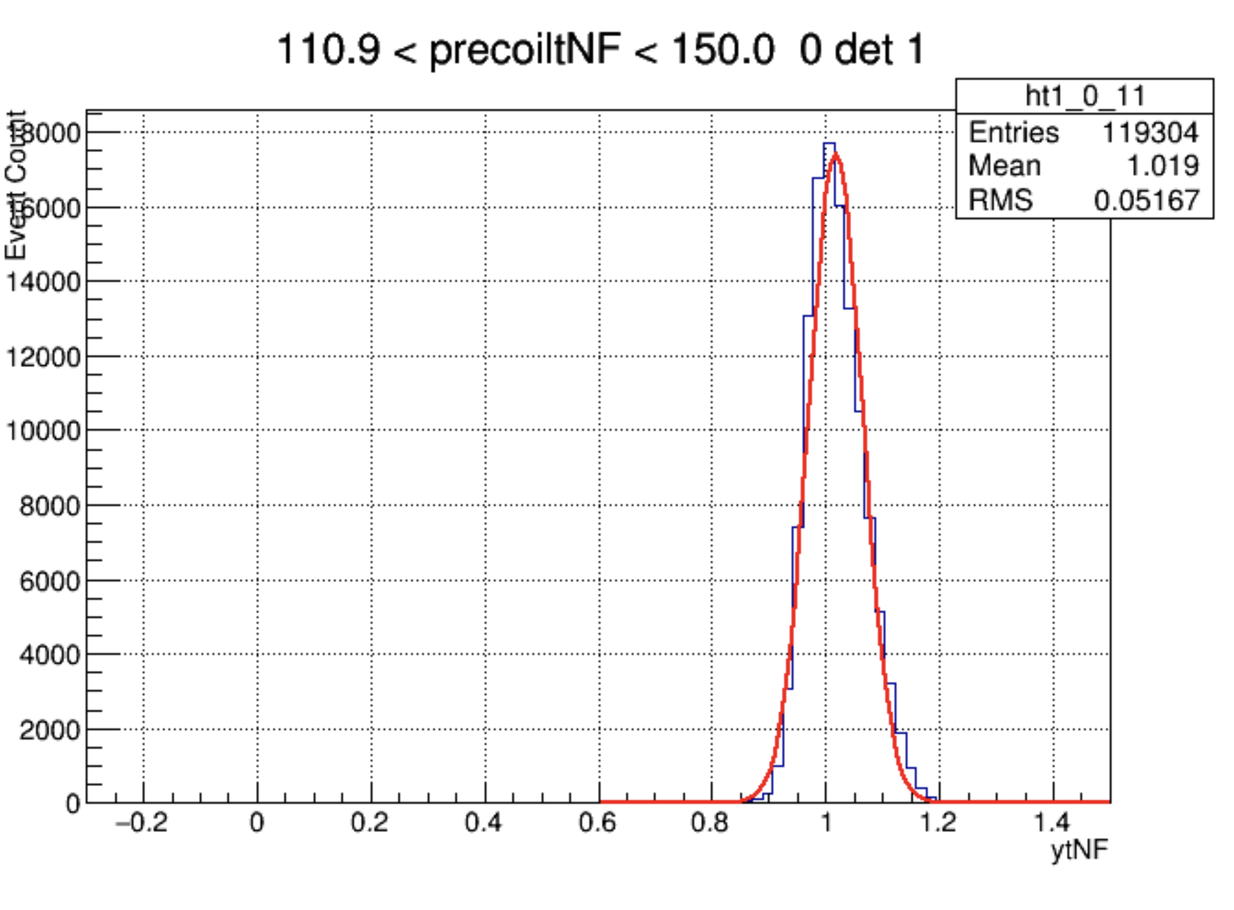
Model Validation (Electron Recoil Band)
A fitted energy distribution fit exists for calibration data.
Data is expected to be normally distributed in each energy bin with a slight skew in the higher energy bins.

Slide 22
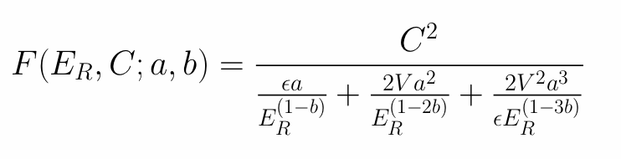
Model Validation (Nuclear Recoil Band)
According to data the nuclear recoil band should be normally distributed through the range of possible recoil energies.
This is much harder to show due to the nonlinearity of the fano factor. As the initial yield model is not normally distributed. (Cauchy(ish)-Distribution)

